Slide 1

Data Science NMP
Presented by:
Faiyam Islam, Klaus Leung, Lynette Zhang

Slide 2
Agenda
Introduction
Understanding the premise, Data pre-processing and data cleaning.
Results
Explanation of results. Linear Regression outputs, LASSO and Ridge
Methodology
Exploratory data analysis (EDA), Simple Linear Regression, Multiple Linear Regression, LASSO and Ridge
Conclusion
Conclusion of results and answering questions.

Slide 3

INTRODUCTION

Slide 4
Introduction
In the NMP (New Member Project), we are given a large dataset of various configurations of a model car. From there we aim to extrapolate relationships from within the data and thus determine the most optimal configuration. Some of the relationships we explore are:
Distribution of lap times.
Speed times.
The path of the car.
How braking affects the lap times.

Slide 5
Introduction → Data - Preprocessing
Dataset of 50 different cars
Need to aggregate
Transpose the input data to match output
Replicate the dataset
Append the replicate input data to output data
Then join them together
Renaming certain variables for clarity
Constructed data frame will be used in analysis

Slide 6
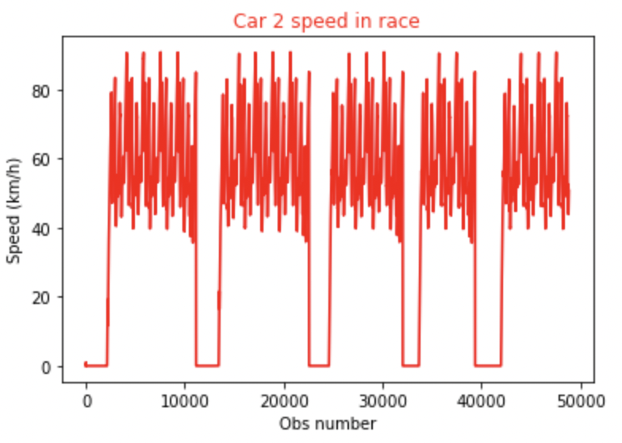
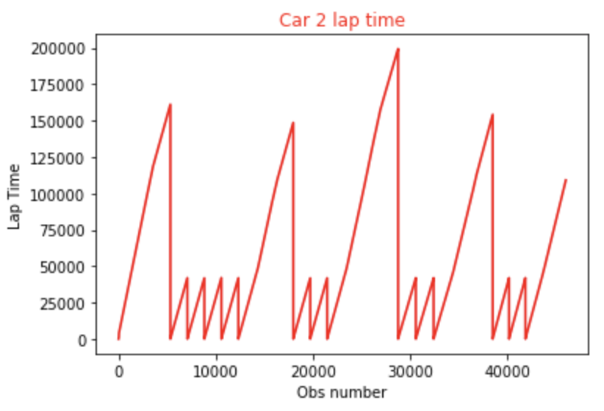
Introduction → Data - Preprocessing → Exploratory Data Analysis (EDA)
Patterns in speed show a regular fluctuation between 40-80 km/h.
Regular spikes and troughs in the lap time.

Slide 7
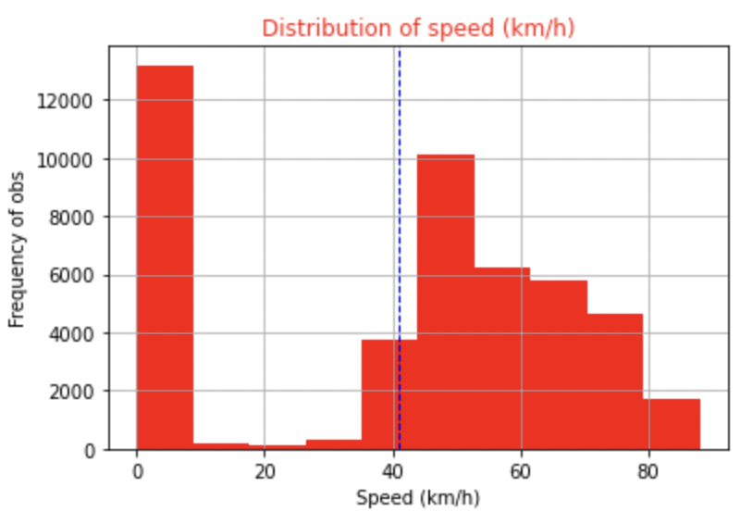
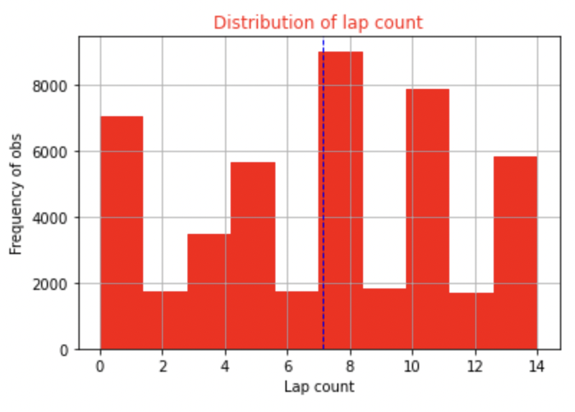
Introduction → Data - Preprocessing → Exploratory Data Analysis (EDA)
Distribution of speed in km/h is positively skewed.
Distribution of lap count is multimodal and neither positive or negatively skewed.

Slide 8
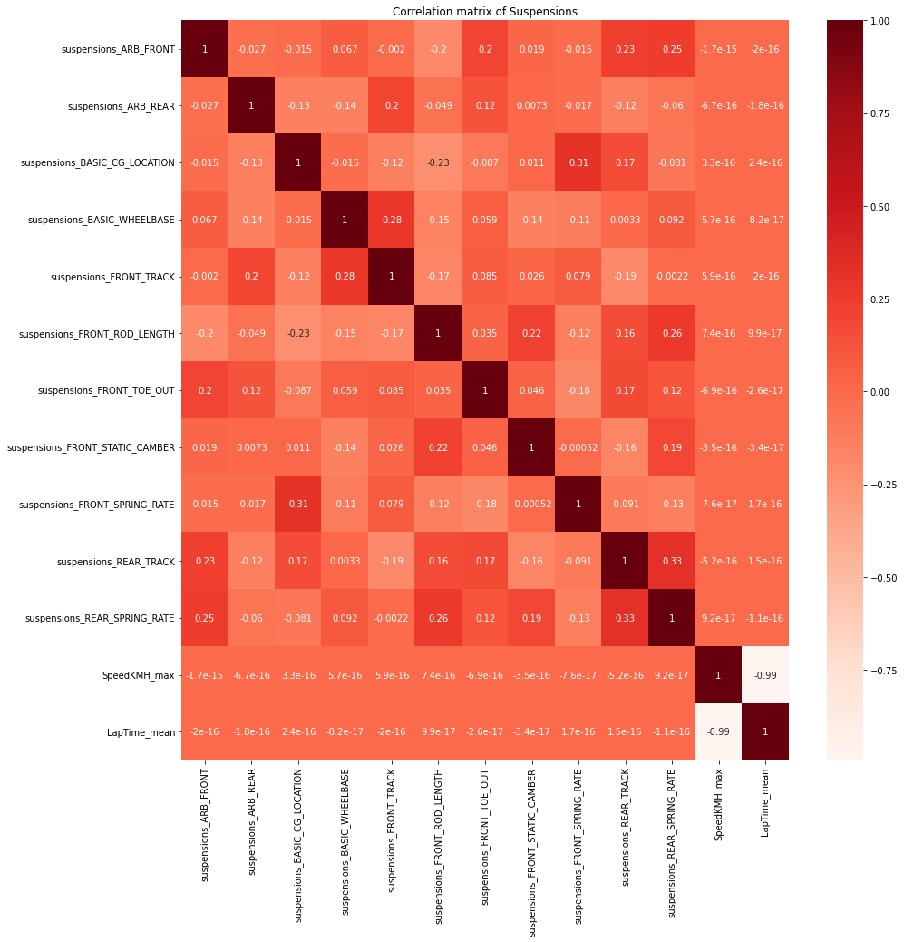
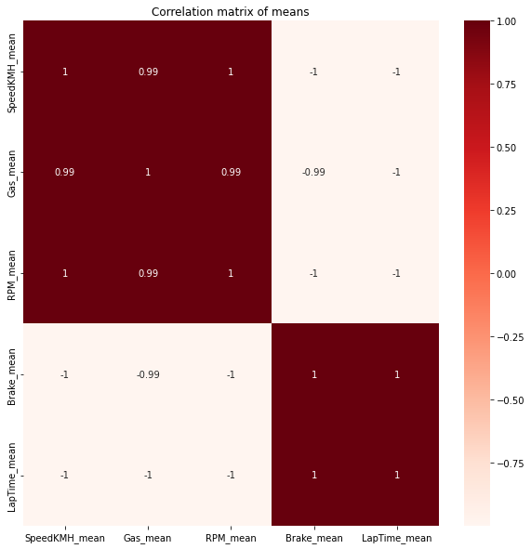
Introduction → Data - Preprocessing → Exploratory Data Analysis (EDA)
Heatmap on right showing correlations of many suspension inputs
Introductory analysis on different characteristics

Slide 9
METHODOLOGY

Slide 10
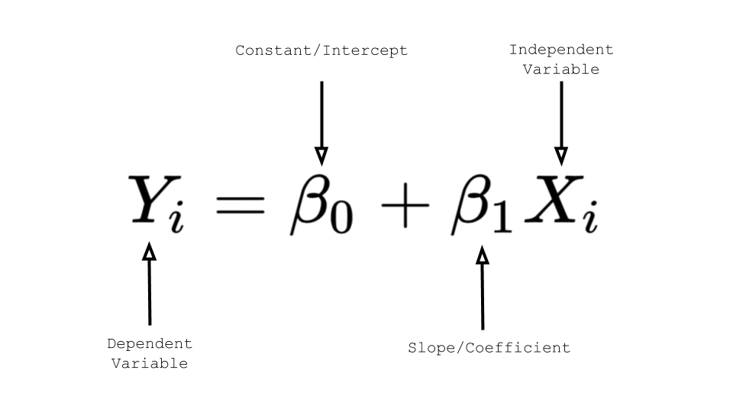
Methodology → Simple Linear Regression
Regression analysis to determine linear relationships between covariates and dependent variable
Primary focus on lap time and speed of each vehicle, this is our Y

Slide 11
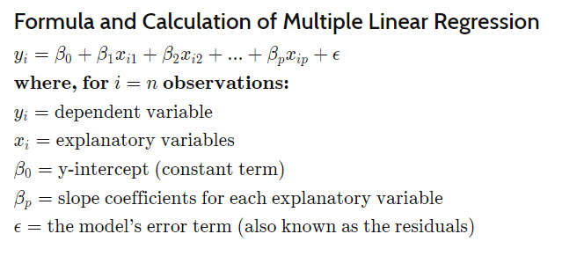
Methodology → Multi-Linear Regression
Multi Linear Regression is simply an expanded form, allowing for one to see the effects of the changes of multiple inputs simultaneously

Slide 12




Methodology → LASSO
LASSO and Ridge used as a regularisation method for regression.
To determine which parameters are useful to us when determining speed and lap time.
LASSO:
LASSO method estimates wdaw by minimising the sum of squared errors plus a penalty term on .
is the absolute value of , ds controls the penalty, it’s called the shrinkage parameter.
The shrinkage parameter is an attractive feature for variable selection.

Slide 13
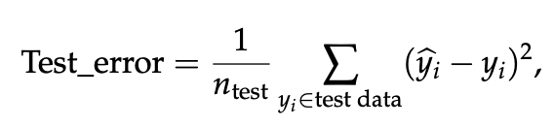
Methodology → Ridge
Ridge:
Ridge regression is a model tuning method that is used to analyse any data that suffers from multicollinearity.
The LASSO and Ridge techniques will be compared using the cross validation Root Mean Squared Error, that will determine which model produces the lowest test error.
where n_test is the number of observations in the attest data.

Slide 14
RESULTS

Slide 15
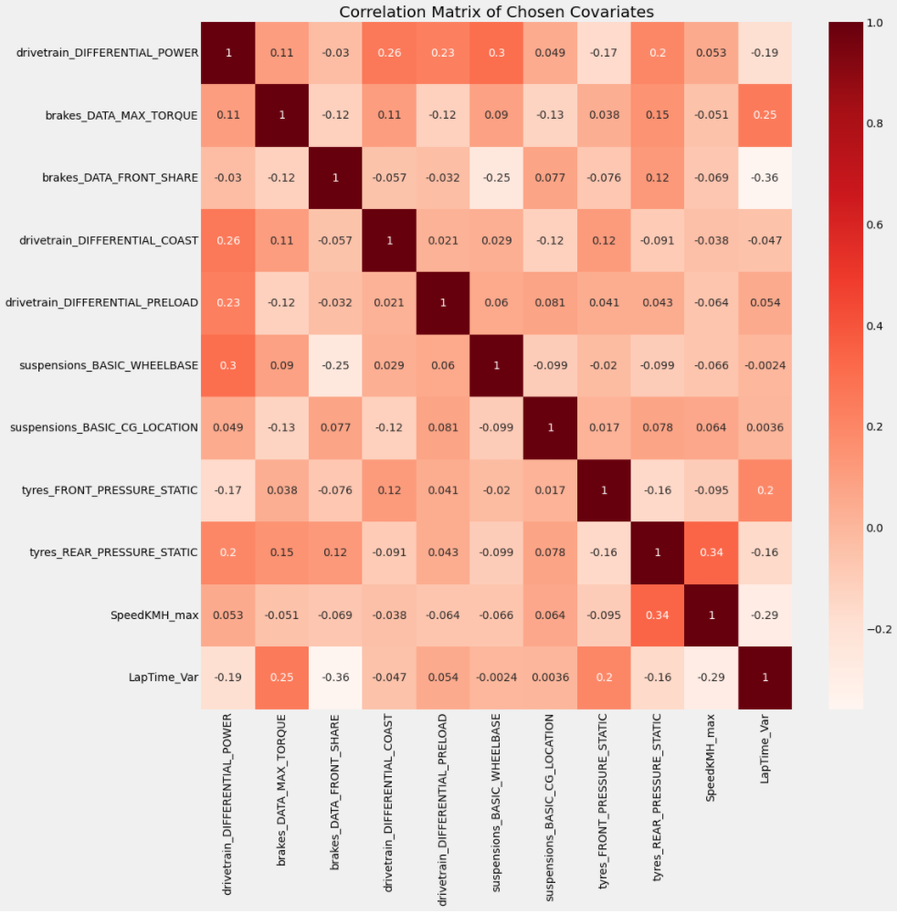
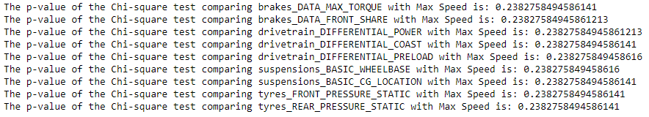
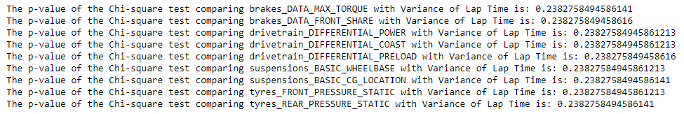
Results → Regression Analysis
Chi-squared test of Independence (Max Speed)
Chi-squared test of Independence (Variance of Lap Time)
The results align with the correlation matrix, under a significance level of 5% we cannot reject the null: the two variates we compared are independent
Most of the values in the correlation matrix are near 0
Further research into the data was necessary
There is a clear mixture of positive and negative correlations

Slide 16
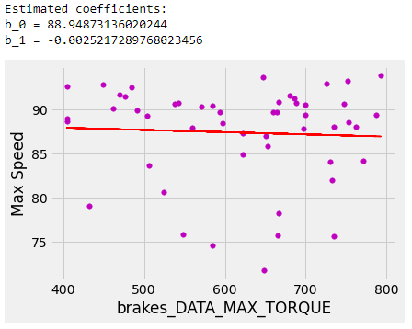
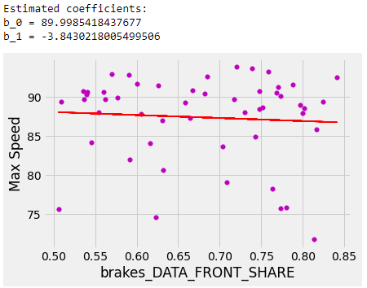
Simple Linear Regression - Brakes → Max Speed
Overall, as the braking units increases, it decreases the max speed of the racing car
Quite a logical conclusion

Slide 17
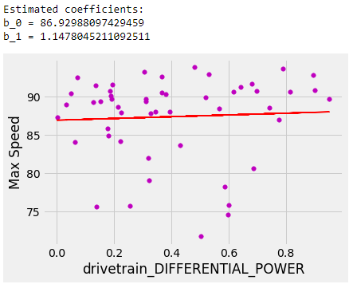
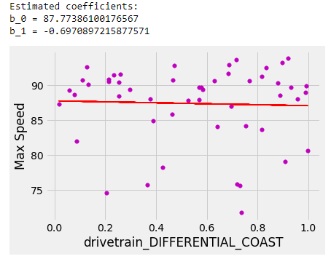
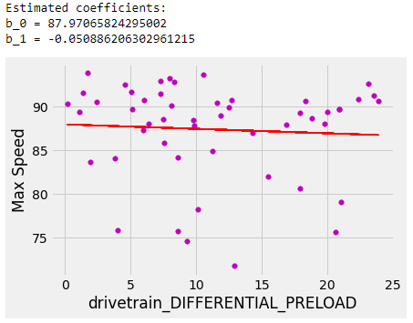
Simple Linear Regression - Drivetrain → Max Speed
Different aspects of drivetrain correlate differently with the max speed of the car
We can optimise drivetrain by analysing the 3 regression lines

Slide 18
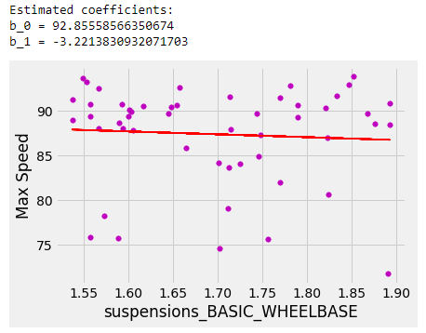
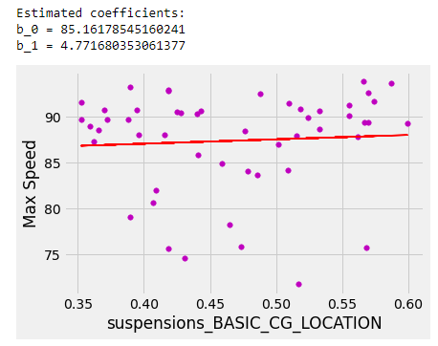
Simple Linear Regression - Suspensions → Max Speed
The chosen suspension categories clearly have opposite gradients
Negative correlation between the two

Slide 19
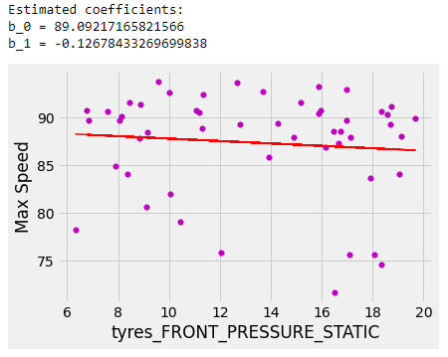
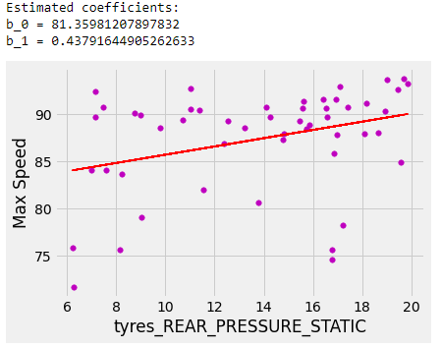
Simple Linear Regression - Tyre Pressure → Max Speed
Interesting to note the opposite gradients
Higher front tyre pressure may lead to lower max speed
Higher rear tyre pressure may lead to higher max speed

Slide 20
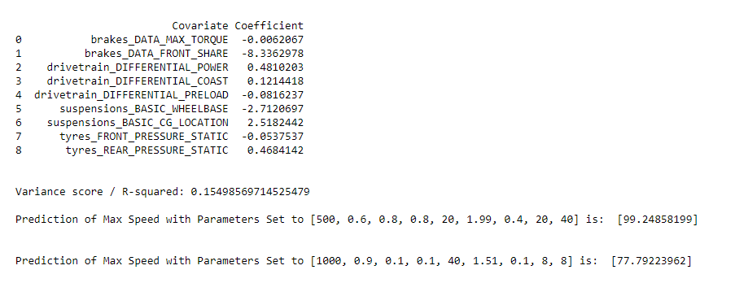
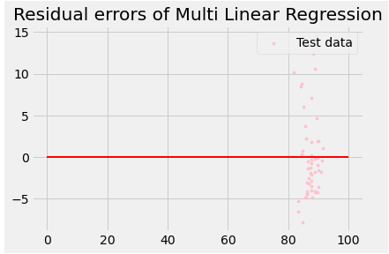
Multi Linear Regression → Max Speed
We created a model that takes in inputs for desired parameters, and will predict the maximum speed of the car with said inputs
This is done as the model calculates all the coefficients for the desired parameters
The Variance Score is 0.15, not as desirable as a score close to 1, but does make for interesting links and insights
Above is 2 performed predictions on a set of different inputs

Slide 21
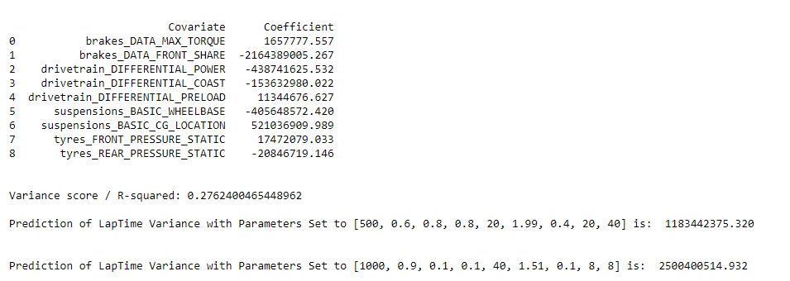
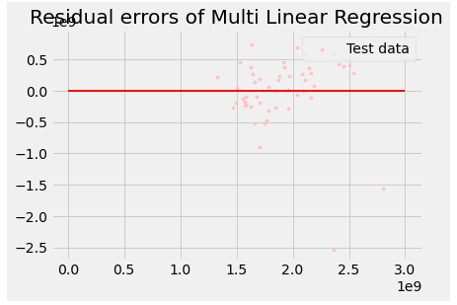
Multi Linear Regression → Variance of Lap Times
We created a model that takes in inputs for desired parameters, and will predict the variance of the lap times of the car with said inputs
This is done as the model calculates all the coefficients for the desired parameters
The Variance Score here is 0.276, higher than the regression on max speed but still not as desirable as a score close to 1.
There are 2 performed predictions of Lap Time variance shown above

Slide 22
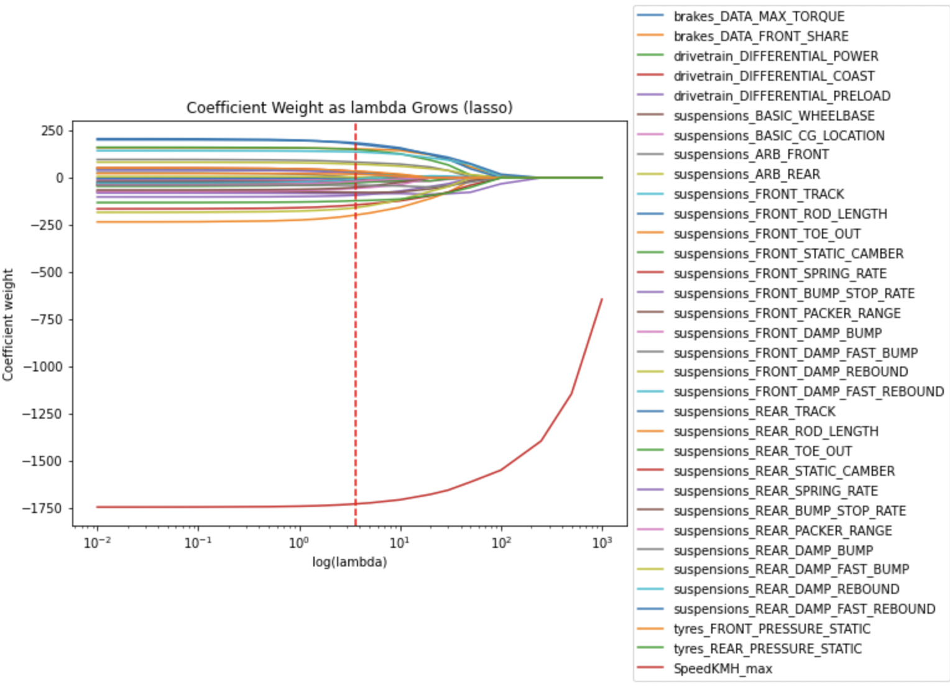
LASSO → Predictive Modelling for Lap Time
LASSO lambda: 46.08 (2 d.p)
Plot displays how each coefficient weighs as the lambda value grows.
To determine redundant variables we look at which covariates are equal to 0.
[Appendix A] - From the LASSO output, for lap time, we determine that the insignificant covariates are:
brakes_DATA_MAX_TORQUE
suspensions_BASIC_WHEELBASE
suspensions_FRONT_ROD_LENGTH
suspensions_FRONT_SPRING_RATE
suspensions_FRONT_DAMP_FAST_BUMP
suspensions_FRONT_DAMP_REBOUND
suspensions_REAR_TOE_OUT
suspensions_REAR_SPRING_RATE
suspensions_REAR_PACKER_RANGE

Slide 23
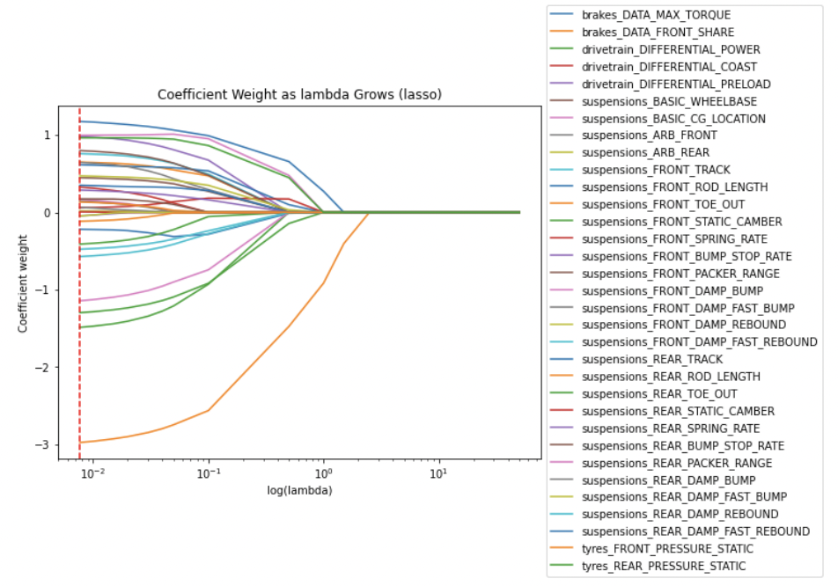
LASSO → Predictive Modelling for Speed
LASSO lambda: 0.01 (2 d.p)
Plot displays how each coefficient weighs as the lambda value grows.
To determine redundant variables we look at which covariates are equal to 0.
[Appendix B] - From the LASSO output, for lap time, we determine that all the variables are significant.

Slide 24
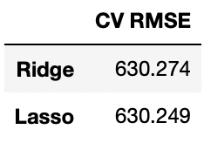
Ridge → Comparison with LASSO
Ridge Lambda: 0.18 (2 d.p)
Using LASSO to select the best covariates then running Ridge showcases that the CV RMSE are almost identical, however LASSO has a lower RMSE.
One method that can be used to attain even better model performance is through interaction terms.
This procedure is called feature engineering.

Slide 25
CONCLUSION

Slide 26
Conclusion → Simple Linear Regression Analysis
We were able to effectively fit a simple linear linear model, to predict the responses
Max Speed
Lap Time Variance
The inputs analysed were
brakes_DATA_MAX_TORQUE
brakes_DATA_FRONT_SHARE
drivetrain_DIFFERENTIAL_COAST
drivetrain_DIFFERENTIAL_PRELOAD
drivetrain_DIFFERENTIAL_POWER
suspensions_BASIC_WHEELBASE
suspensions_BASIC_CG_LOCATION
tyres_FRONT_PRESSURE_STATIC
tyres_REAR_PRESSURE_STATIC
This allows us to view the individual changes on these inputs and their effects, allowing for one to finetune the race car with a reasonable prediction

Slide 27
Conclusion → Multi Linear Regression Analysis
We were able to effectively fit a multi linear model, to predict the responses
Max Speed
Lap Time Variance
The inputs analysed were the same as in our simple linear regression
This allows us to view the effect of a change in input in tandem with other inputs, allowing for one to finetune the race car with a more general picture
Any value for the parameters is able to be tested, allowing one to study the setup leading to the lowest lap time variance for example
Our model for predicting lap time variance is more accurate than max speed, as the R-squared scores are 0.276 and 0.155 respectively

Slide 28
Conclusion → LASSO and Ridge
Using LASSO we conclude that all the variables except
brakes_DATA_MAX_TORQUE
suspensions_BASIC_WHEELBASE
suspensions_FRONT_ROD_LENGTH
suspensions_FRONT_SPRING_RATE
suspensions_FRONT_DAMP_FAST_BUMP
suspensions_FRONT_DAMP_REBOUND
suspensions_REAR_TOE_OUT
suspensions_REAR_SPRING_RATE
suspensions_REAR_PACKER_RANGE
Should be included for optimal performance in lap time. However, we confirm that all the variables are necessary when achieving the desirable result in speed for the vehicles.

Slide 29
Conclusion → LASSO and Ridge
From the previous slide, we decided to compare the CV (cross validation) RMSE (Root Mean Squared Error) of lap time LASSO.
Although both CV RMSE are very similar, the optimal model that will produce the best lap time for the vehicles will utilise LASSO.

Slide 30
APPENDIX

Slide 31
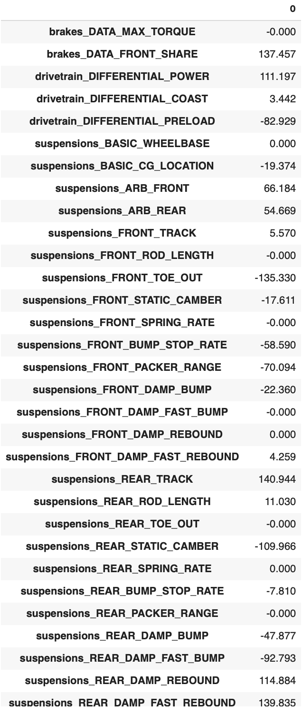
Appendix
Appendix A (LASSO for lap time)

Slide 32
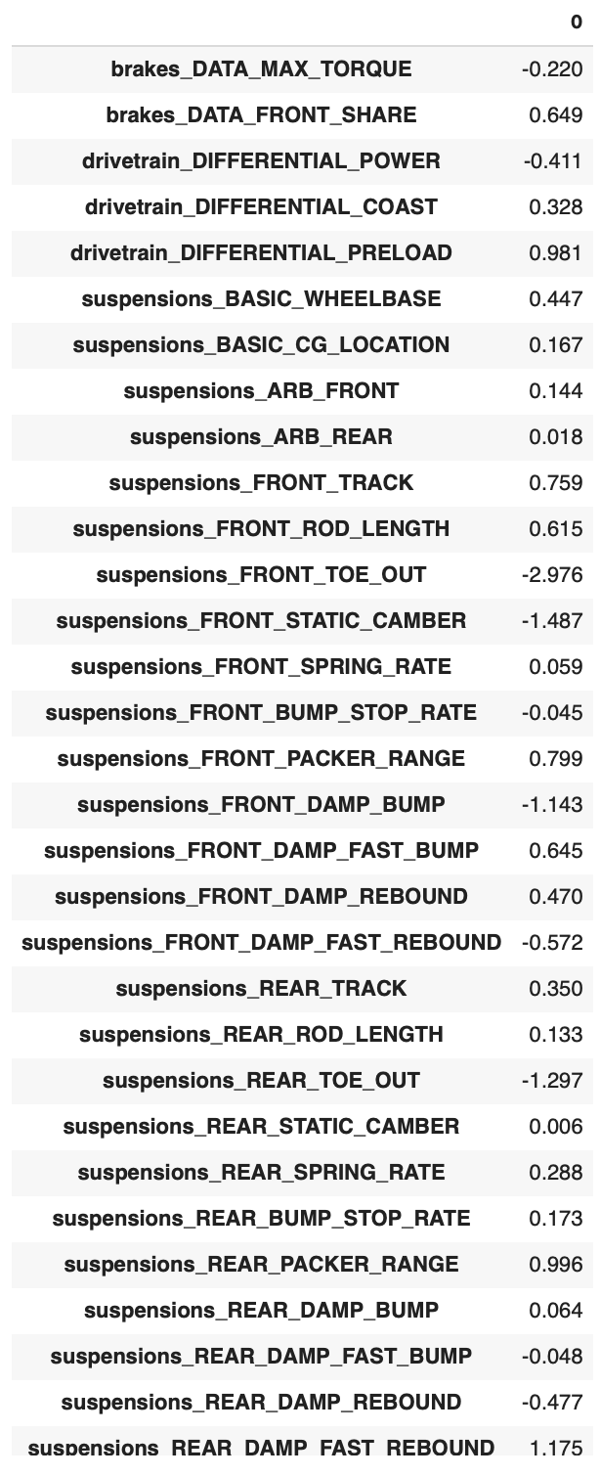
Appendix
Appendix B (LASSO for speed)

Slide 33
THANK YOU FOR LISTENING!
Time for Questions and Answers.

